Slide 1
Twibo
A Mixed client for Weibo and Twitter

Slide 2
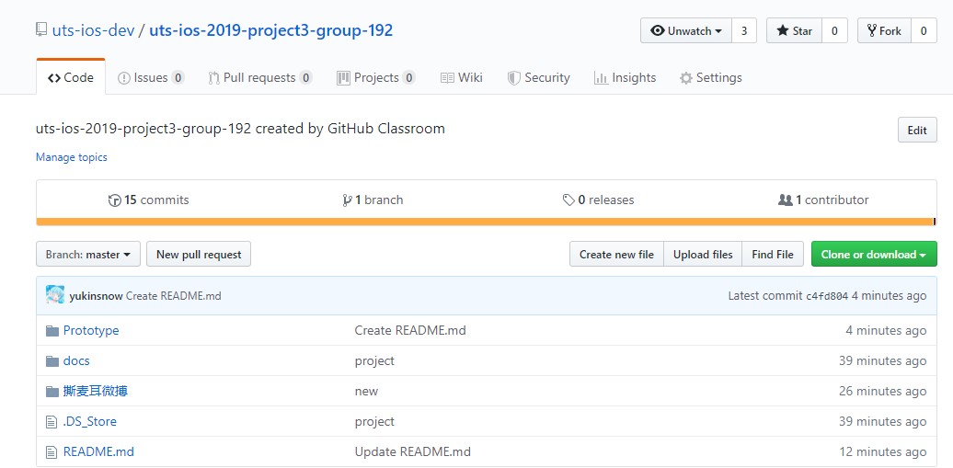

Slide 3


＋

Slide 4
Prototype

Slide 5
CoreData
UIKit
WebKit
pod 'Alamofire'
pod 'SDWebImage'
pod 'SnapKit'
pod 'SVProgressHUD'
pod 'AFNetworking'
pod 'MJRefresh'

Slide 6
Demo

Slide 7
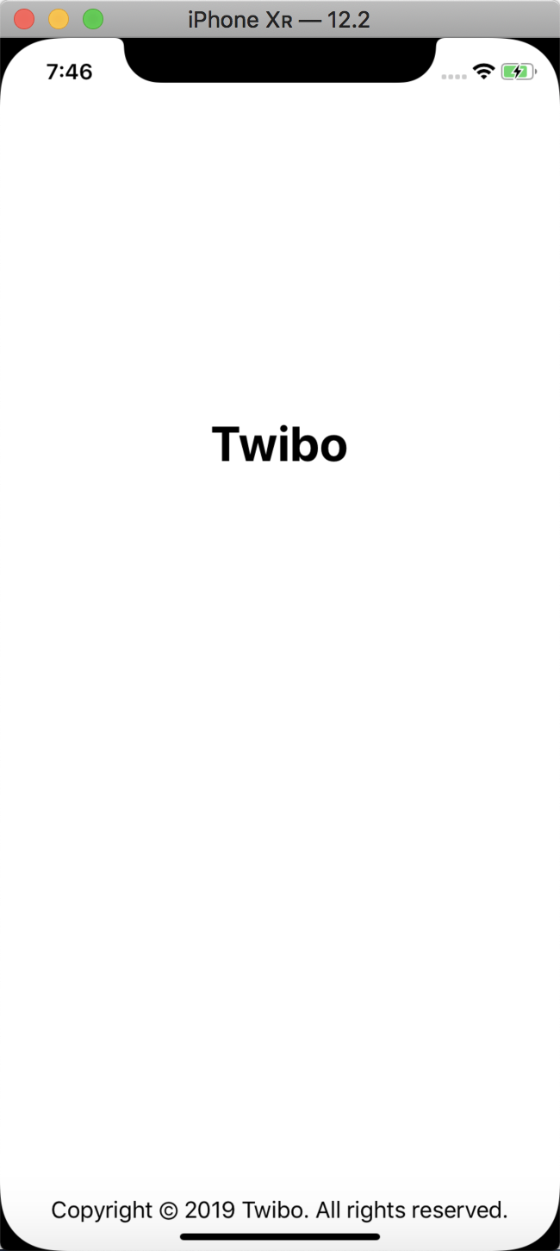
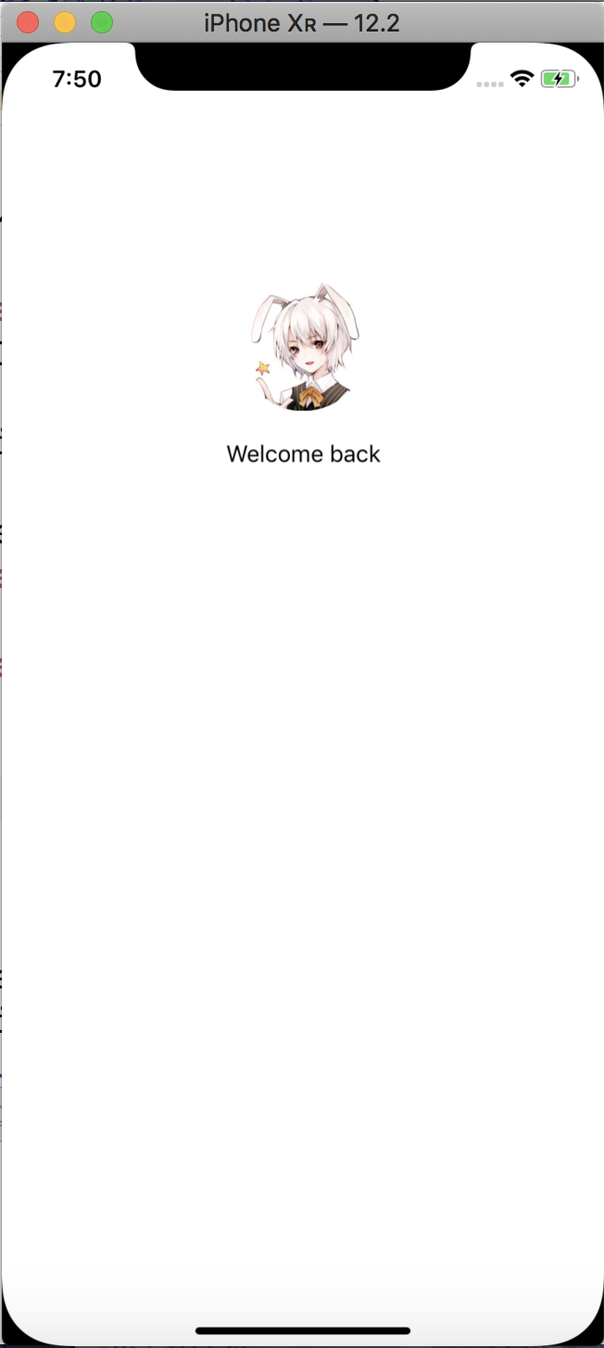
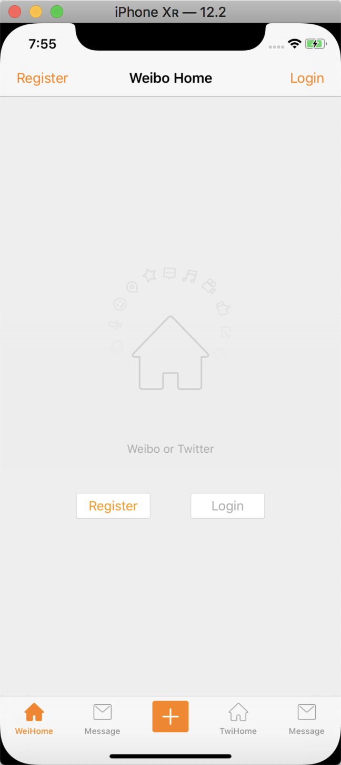

Slide 8
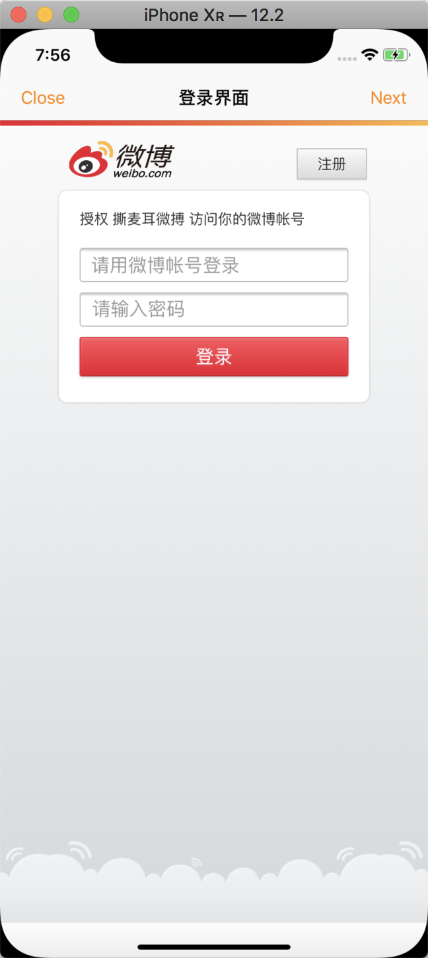
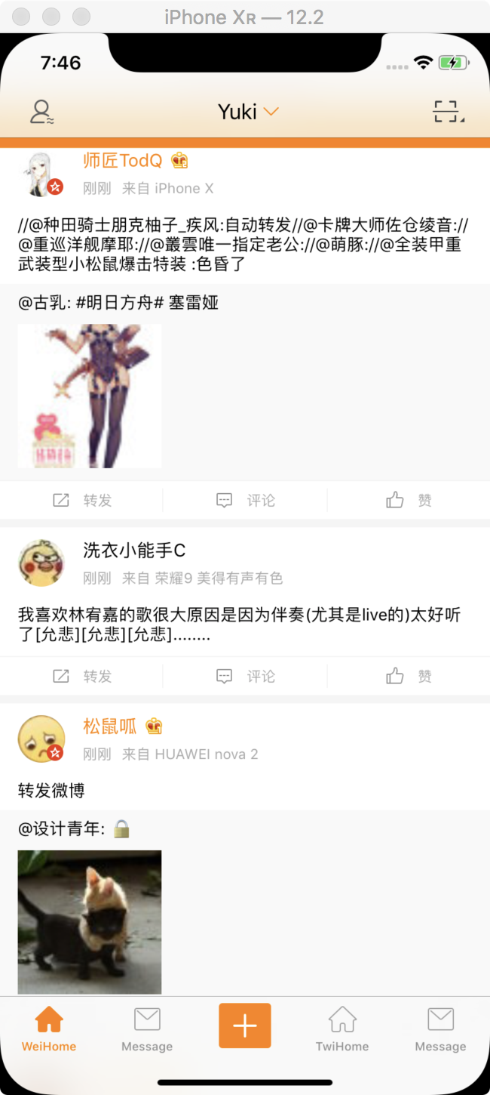
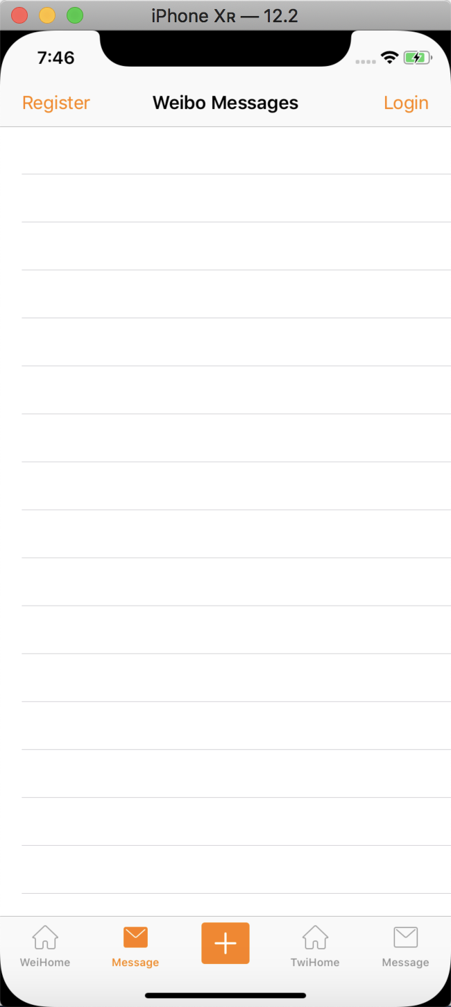

Slide 9
